Slide 1


Transforming the Automobile Insurance Claims through GenAI
Finalised Solution
Team AI & Data | Aug 2024

Slide 2

Agenda
1
Revised Options Analysis Slide 3 — 4
2
Completed Tasks Slide 5 — 6
3
Development Pipeline
Slide 7 — 10
4
User Stories
Slide 11 — 12
5
Future Tasks Slide 13 — 14
6
Roadblocks Slide 15 — 16

Slide 3


1
Revised Options Analysis
‹#›

Slide 4
Options Analysis
Option 2 | Feasibility | Solution Name | Solution Cost
Data Team | Cost-effective: more cost-effective for small/medium workloads. Simplicity & Speed: Azure Functions are easier to set up and deploy → faster development time Scalability Limits: upper timeout durations of 10 minutes thus, issue when our dataset grows Cold Latency Starts: AF is serverless thus, will introduce latency due to cold starts → affect performance | Azure Data Lake (Gen 2) | A$0.44745/month
 |  | Azure Function | The first 400,000 GB/s and 1,000,000 executions are free. Each 1,000,000 executions more is A$0.31
AI Team | Advanced Capabilities: Combines the strengths of machine learning and anomaly detection with cutting-edge AI technologies like GPT-4, offering a comprehensive fraud detection solution. Scalability: The AI-driven solution is highly scalable, making it suitable for large organizations with operations across multiple geographies. Flexibility: GPT-4 offers unparalleled flexibility in fraud detection, with the ability to adapt to new data sources, integrate with various systems, and evolve with emerging fraud patterns. | Azure AI Studios | Free (used to hold GPT-4o and E8a V4)
 |  | Azure OpenAI Service (GPT-4o-mini) | GPT-4o-mini: A$0.00023 per 1,000 input*; A$0.0010 per 1,000 output*
 |  | Azure Machine Learning (E8a v4) | A$0.925/hour**
 |  | Microsoft Defender for Cloud (per billable resource) | $0.011/h x 24 hours x 30 days = $7.92 Four billable resources in total 7.92*4= A$31.68
Total Options Cost |  |  | A$78.38/month
*Microsoft offers 100 USD in credit for all Azure products if using university email during registration.
*Assumption of 1,000 input & output **Assuming 50 hours on Azure ML
***Month has 30 days
Notes:
Data Team - Ninuri
AI Team - Eugene

Slide 5

2
Completed Tasks
‹#›

Slide 6
Completed Tasks
Team AI Tasks
Team Data Tasks
Deliverable 2 draft
Deliverable 2 Draft Made & Sent To EY
Completed Requirements/Scoping document
Github Setup with Project board
Revised the price column of the options analysis
Primary data source finalised
Completed the prioritised user stories
Infrastructure is up for core services
Identified all necessary Azure products
Completed user stories
Explored how Azure AI Studios operates
Notes:
Data team - Alan
Ai team - Eugene

Slide 7
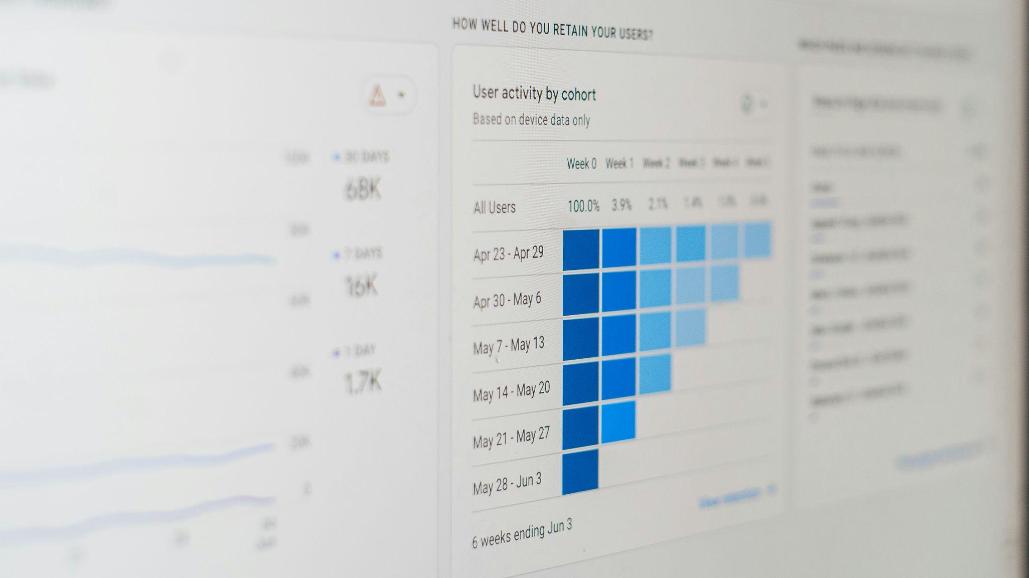
3
Development Pipeline
‹#›

Slide 8
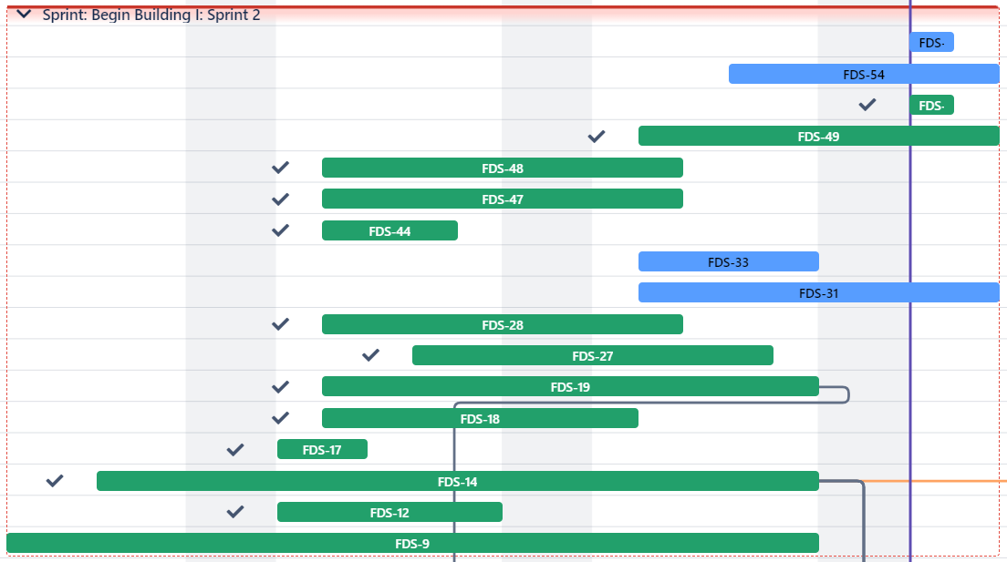
Combined Gantt Chart
Notes:
Data team - Noor
Ai - Eugene

Slide 9
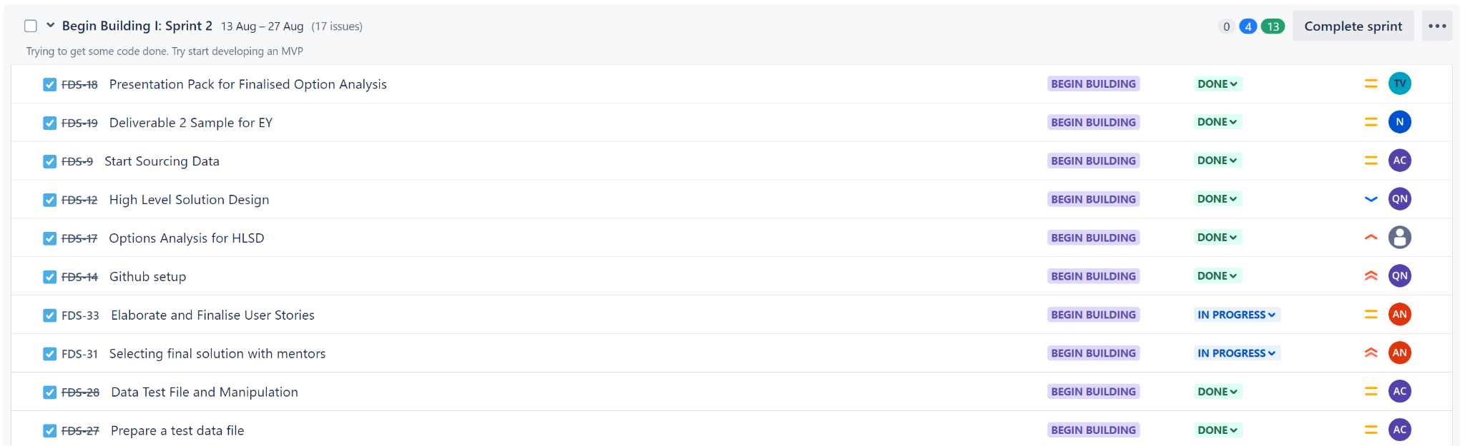
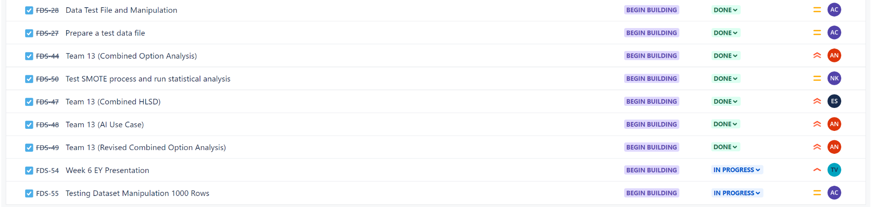
Sprint 2: Tasks Backlog
Notes:
Data team - Noor
Ai - Eugene

Slide 10
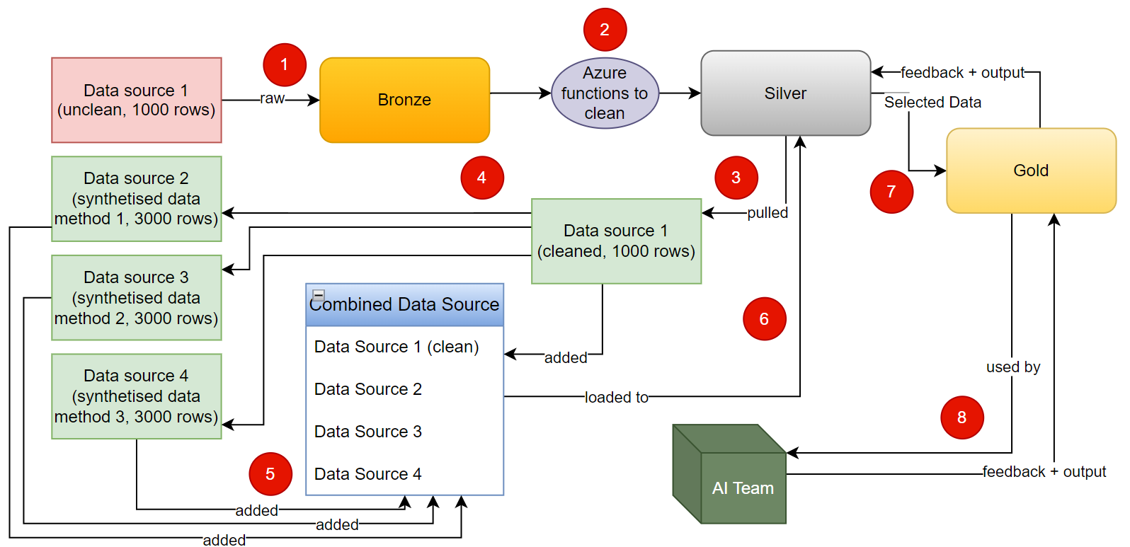
Development Pipeline Diagram
Data Team:
Notes:
Data team - Noor
Load (raw) Data into Bronze
Clean Data then send to Silver
Create More Data (from Silver Data)
Combine All Data then send back to Silver
Move Relevant Metadata to Gold
Send Gold Database to AI Team
Have Feedback + Output Loop between AI Team & Gold AND Gold & Silver Layers

Slide 11

4
User Stories
Notes:
Data - Tash

Slide 12
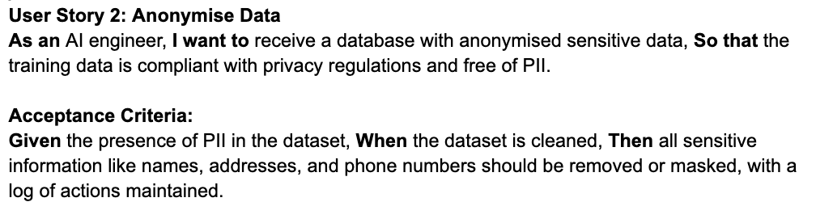
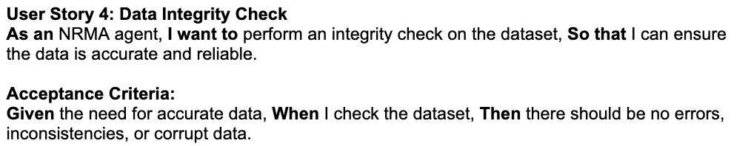
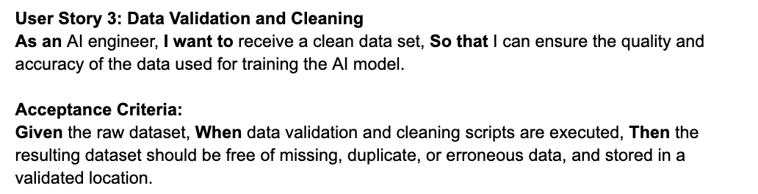
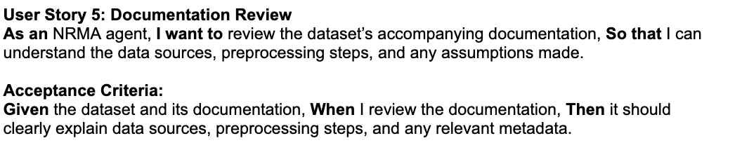
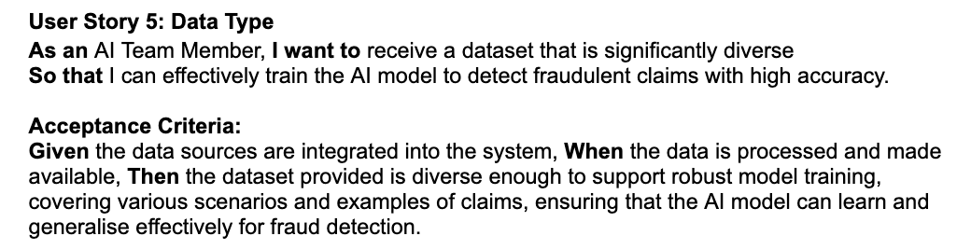
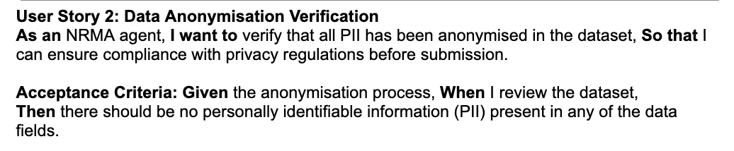
User Stories - Data Team
AI Team
NRMA (Client)

Slide 13

5
Future Tasks
‹#›
Notes:
Data - Adam

Slide 14
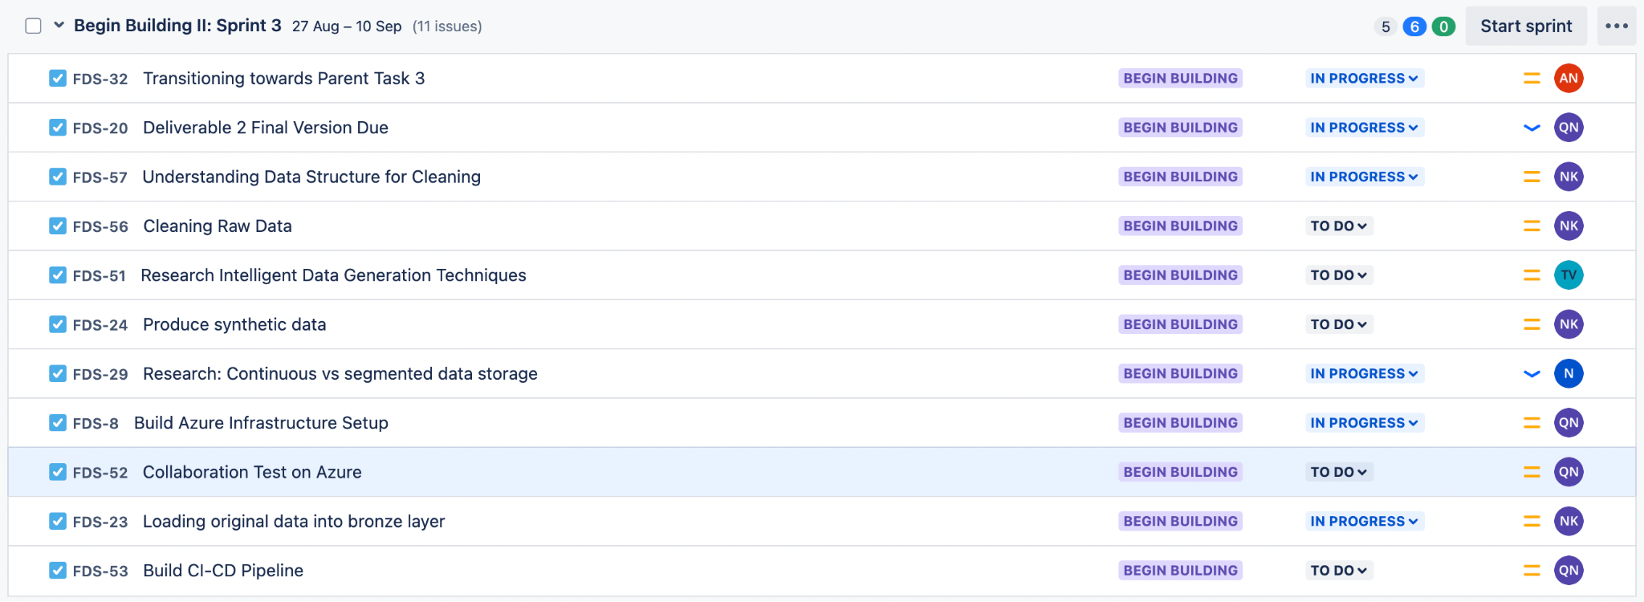
Sprint 3
Tasks Backlog for sprint 3

Slide 15

6
Roadblocks
‹#›

Slide 16
Roadblocks
❌
Methods to synthesise data
Segmented or continuous data?
Categorical data or numerical data?
How to Clean Data?
A payment per model is limited to only one account.
❌
❌
❌
❌
Notes:
Ai - Akriti

Slide 17
Thank You

